Slide 1
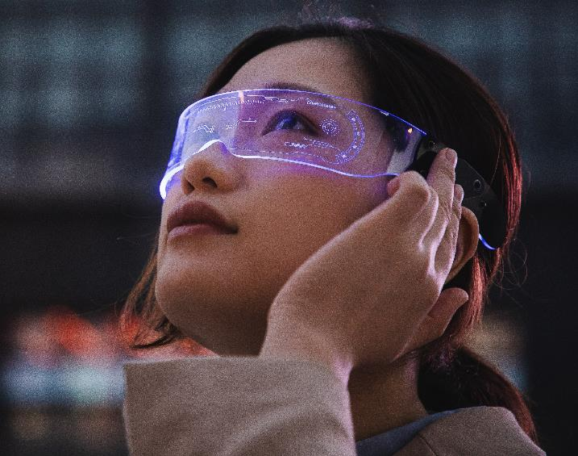
Google Glass
TEM-401
​Benjamin Horn
Sankalp Saoji
Melissa MacLiesh
Piyush Bhardwaj
Thomas Preetham

Slide 2
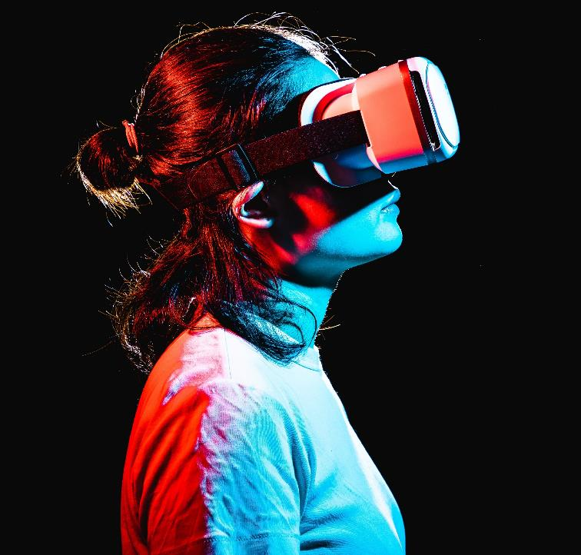
About Google Glass
Google Glass Explorer Edition released April 15, 2013
Goal: Provide a hands-free augmented reality with a smart display in the corner of your vision
Originally available to “qualified Glass Explorers” for 1 month before open to the public for a price of $1,500
Requires the “My Glass” app from a smartphone to function
Able to: take photos, record video, get directions, send a message, phone call, google search

Slide 3
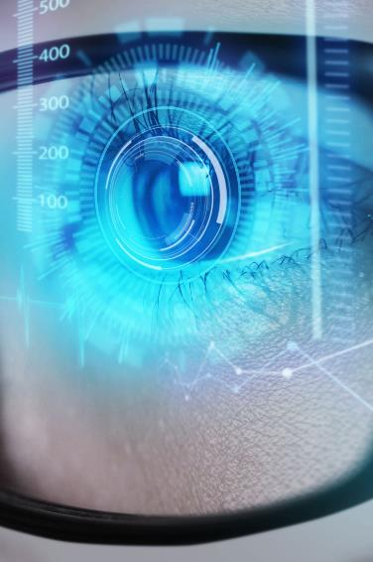
The 4Ps
Product
Price
A wearable “smart glass”. It’s a voice and motion-controlled gadget that looks like a pair of glasses and can display information right in front of the user’s eyes.
Google Glass is priced at $1500 dollars per unit. Many find this to be exorbitant for the benefit they receive for the product. Though it takes only $152 to manufacture the glasses, there are other hefty expenses that Google had to swallow.
Place
Promotion
Google Glass was initially exclusively sold to a group of people called “Glass Explorers.” A large portion of this group consisted of journalists who would not benefit from Google Glass’ primary features.
The Google Glass campaign has had some fantastic first steps. They have created a critical mass and some great buzz for their campaign. there were over 145K mentions of the #ifIhadGlass hashtag

Slide 4
3Cs
Consumer
Relevant attributes: send a message, record a video, get directions, google search all hands free
Weighted attributes: 50% “cool new tech” 30% “overall utility” 20% “new and unique features”
Failed to consider
Societal acceptance: “are you recording me?”
Invasion of privacy
Personal assistant feature “refresh” collects information on people around you through social media
Hype based “cool new tech” heavy weight only lasts for a short time
Overall utility is what is going to carry long term

Slide 5
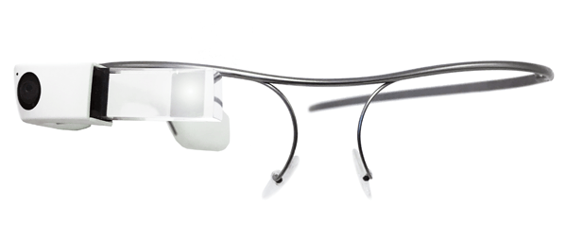
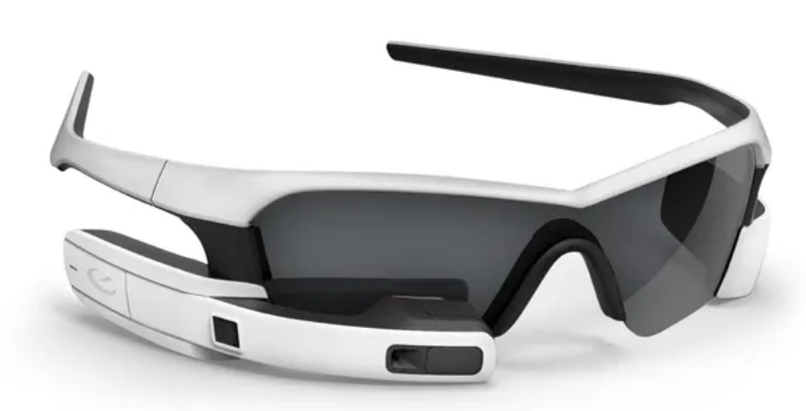
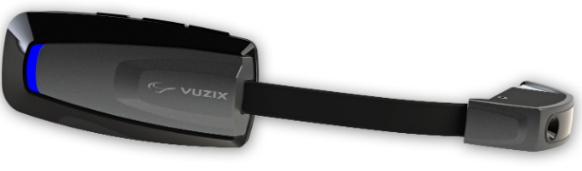
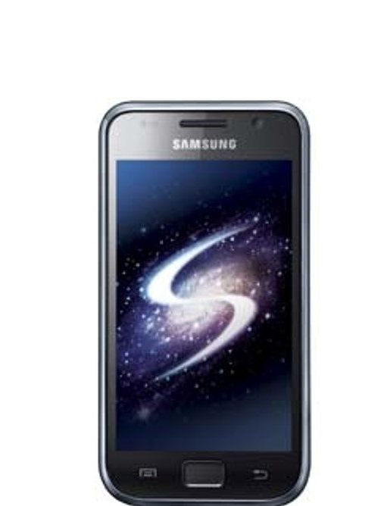
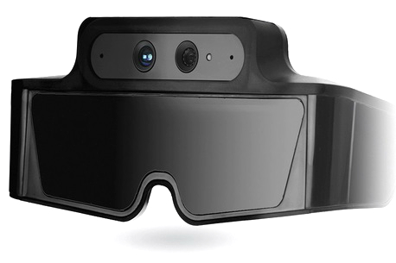
3Cs
Competition
WTP is based on CS_{BA} where P = B – CS_{BA}
Similar product prices in 2013
Recon Jet: $500
Vuzix M100: $500
Meta SpaceGlasses: $670
Failed to consider
What makes their product a standout?
$1500
$650

Slide 6
3Cs
Company
What is the objective?
How much does it cost to make?
How will it be distributed?
Failed to consider
What happens when you deliver a promise and not reality
Media backlash/business bans

Slide 7

Positioning
Target market - all ages (children to adults)
The various attributes people could use it for are:
Work
- pop up reminders, dictate texts
Information
- compass, current weather
Entertainment
- play games, demands app
(wink to take a picture)
Connecting to People
- Google Hangout, sharing pictures, videos, posts
Travel
- travel alerts, maps, directions, check in
The attributes could vary as per the population using. Children could prefer something different and adults something else
​

Slide 8
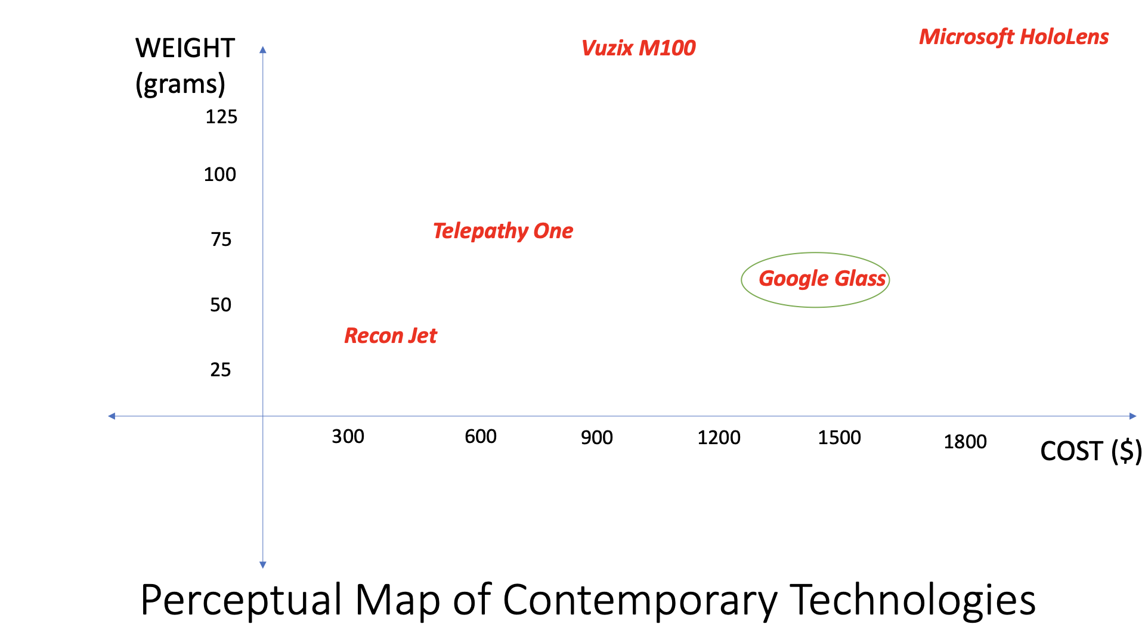
competition

Slide 9
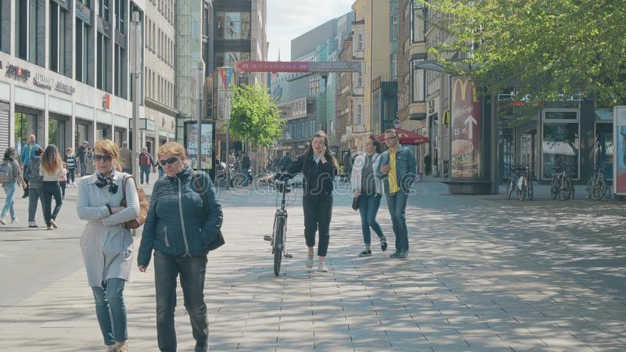
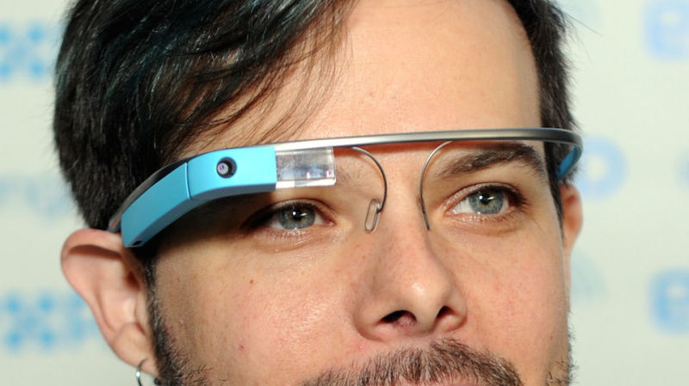


Why Did it Fail?
REC
Security
Fashion Disaster
Too Expensive
Too Expensive
Lack of Use Cases

Slide 10

How could it have been handled better and succeeded?
Google should have focused more on benefits rather than features (or deliverables).
Google should have set an exact date and location for the product’s official launch.
Should have focused on customer feedbacks
Google should have partnered with an eyewear manufacturing company.
The biggest issue with Google Glass is that it targeted the wrong market. Glass could have been a transformational tool for professionals like pilots, police, machine operators, etc.

Slide 11
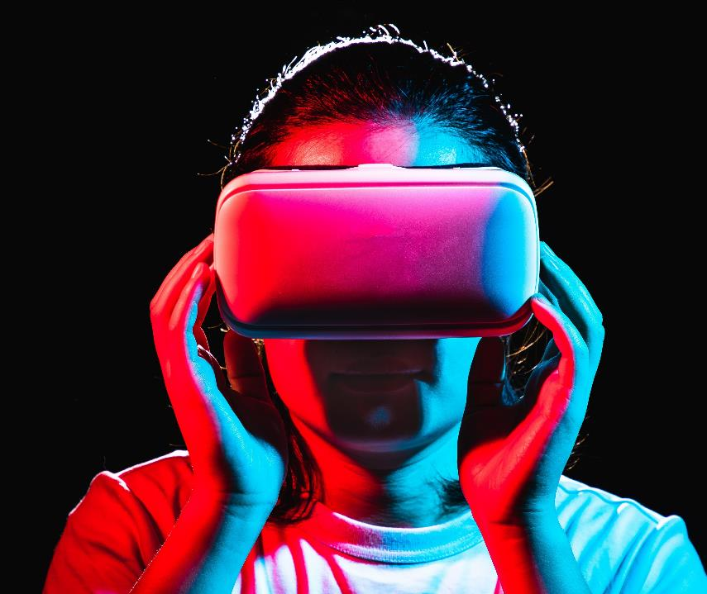
Thank you

